Slide 1
Design & Analysis of Algorithm Hashing
Informatics Department
Parahyangan Catholic University

Slide 2
Motivation
We have seen many data structures: array, linked list, stack, and queue. Each has its own strength and weaknesses
Consider the case when we want to find an element in a data structure
Unsorted array → sequential search O(n)
Sorted array → binary search O(lg n)
Linked list → sequential search O(n)
Can we achieve O(1) performance ?

Slide 3

Analogy
After hours of playing the same hidden object game, we remember where each item is located, thus our search is no longer “sequential”. Moreover, we can find them right away
Notes:
Remembering == our brain maps each item to some location, so finding an item is fast (O(1))

Slide 4
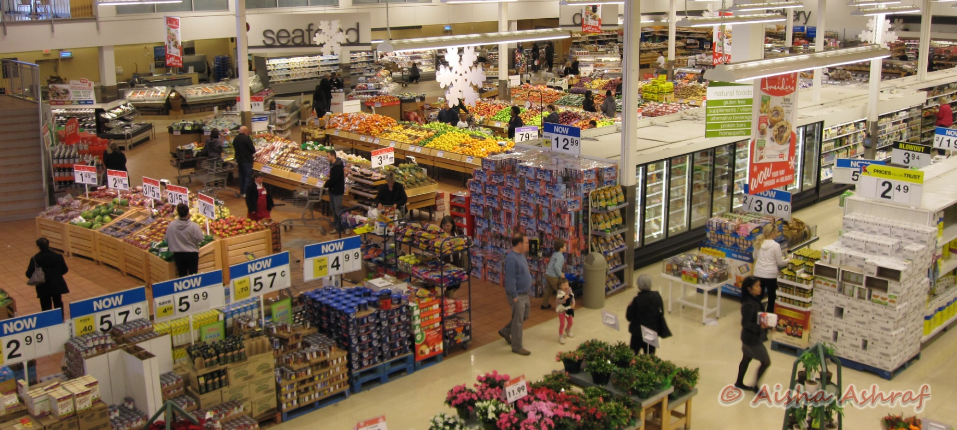
Analogy
We remember which rack sells our favorite item in a supermarket, thus we directly goes to that rack without checking the other racks.

Slide 5
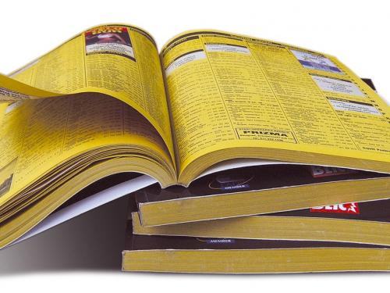
Analogy
We know where to find “Universitas Parahyangan” in Yellow Pages – it must be around the beginning of “P” section.

Slide 6
How does hashing work ?
Associate keys with values
Given a key (e.g. a company’s name), retrieve the value (e.g. phone number, address, etc.) for the given key
A hash function is defined to map the key to an index of a table where the value is stored
e.g. “Universitas Parahyangan” is stored at section “P”
O(1) for insertion and lookup
Is it really O(1)?

Slide 7

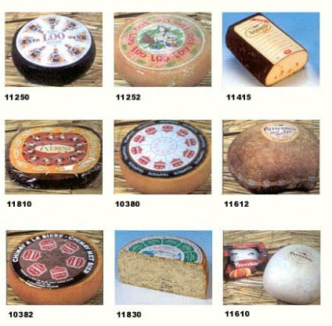
Another Example
Dairy products are barcoded (given a key) and put into “Dairy” rack (mapped to a table)

Slide 8
Another Example
J (74)
K (75)
L (76)
…
S (83)
John Smith
+1-555-1234
John Smith
Lisa Smith
+1-555-8976
Sam Doe
Lisa Smith
Sam Doe
+1-555-5030
DATA = KEY + VALUE
KEY
HASH TABLE

Slide 9
Direct Addressing
If the size of universe of keys is small, and the keys are unique, then we can set up a table whose size is the same as the universe’s size.
Each slot with index k in the table stores element with key k. If no element with key k, then slot with index k is empty

Slide 10
Direct Addressing :: example
Student’s NPM : XXXXYYZZZZ
XXXX = year
YY = faculty and department’s number
ZZZZ = student’s number
Key’s universe is 0000000000 – 9999999999 (10,000,000,000 keys) → very big !
Let’s say we only want to store the data of Informatics Department (YY=73).
Key’s universe is 0000730000 – 9999739999 (100,000,000 keys) → still a lot !

Slide 11
Direct Addressing :: example
First year of Parahyangan’s Informatics Department is 1996. Let’s say we want to store student’s information only up to year 2020.
Key’s universe is 1996730000 – 2020739999 (250,000 keys) → still a lot !
We can save even more by considering that each year’s student never exceed 999 (doesn’t need the 4th digit) and write the year in 2 digits format.

Slide 12
Problems in Direct Addressing
Only implementable if the size of universe is small
What if we want to store IP addresses ? 000.000.000.000 to 255.255.255.255 = 256⁴ × 4 bytes = 16 GB space
What if we want to store 10 characters names ? = 26¹⁰ = 141,167,095,653,376
What if we want to store 16 digits KTP numbers ? = 10¹⁶ = 10,000,000,000,000,000
What if 50 characters address ?
When the size is big:
Requires too much memory space
Inefficient if only a small portion of the keys are stored
Solution:
Use hash table with size |K| = the number of keys stored e.g. in the previous example, we don’t need to prepare a space for data before year 1996
Requires fewer storage space but still O(1) time complexity for lookup

Slide 13
Hash Function & Hash Table
A hash function h(k) is defined to map the key k to an index of a table where the element with key k is stored
J (74)
K (75)
L (76)
…
S (83)
John Smith
Hash function
e.g. take the ASCII number of the first character
Sam Doe
Lisa Smith
The value h(k) is called hash value
KEY
HASH
TABLE

Slide 14
Example :: NPM
1996730023
2000730055
2010730111
Hash function :
Extract the last 2 digits of year
Extract the last 3 digits of student number
Concatenate the two of them
96023
00055
10111

Slide 15
Collision
Since the storage size is reduced, two distinct keys k₁ and k₂ may be mapped to the same index h(k₁) = h(k₂)
This condition is known as collision → resolution strategy is required (we shall see later)
Example:
J (74)
K (75)
L (76)
…
Hash function
e.g. take the ASCII number of the first character
John Smith
Jane Smith

Slide 16
Choosing Hash Function
Deterministic h(k) always gives the same result for the same k
Easy to compute needs to be O(1), otherwise insertion and lookup become expensive
The range has to agree with table size must not map any value outside the hash table

Slide 17
Types of Hash Function
Modular/Division
Truncation
Multiplicative
Folding
Length-dependent

Slide 18
Hash Function Modular/Division
Define the table size M
h(k) = k mod M
M should be prime numbers, since prime numbers provide better distribution in the table
Why should M be prime ?

Slide 19
Hash Function Modular/Division
Suppose we want to store NPM into a hash table with hash function h(k) = k mod 100 So, only the last 2 digits of NPM determine the hash value
Why should M be prime ?
Observe that there are more students with small NPM than students with large NPM.
Additionally, NPM ≥100 are also hashed to index 0..99, thus the smaller indexes have more collisions
Using prime number for M gives a better distribution (thus less collisions) because every digits of the key contribute to the hash value.

Slide 20
Hash Function Truncation
Take the last n digits/characters as table index e.g. taking the last 3 digits of your NPM
Fast, but often cannot evenly distribute the keys in the table
What is the difference with Modulo/Division method ?
Similar reason as the previous example

Slide 21
Hash Function Multiplicative
Suppose we have a floating point key k, 0 ≤ k < 1
And a hash table of size M
Define
M = 10
0 | 1 | 2 | 3 | 4 | 5 | 6 | 7 | 8 | 9
k = 0.7237378
k = 0.3562319

Slide 22
Hash Function Multiplicative
What if key’s domain is not a floating point ?
Choose a floating point A in the range 0 < A < 1
Define
floating point
floating point ranged 0..1

Slide 23
Hash Function Multiplicative
Does the value of M matter ?
M doesn’t matter ☺
Usually M is a power of 2 since it’s easier to implement on most computer
Does the value of A matter ?
This method works practically with any valid A, but some works better than the other
Knuth suggest that A ≈ (√5 – 1)/2 = 0.6180339887… (golden ratio) is likely to work reasonably well
Disadvantage ?
Computing hash value is slower than modular method
Notes:
See “Introduction to Algorithms book

Slide 24

Hash Function Boundary Folding
Just like folding a paper
1 2 3
1 2 3
4 5 6
4 5 6
7 8 9
7 8 9
0 9 8
0 9 8
reversed
normal
3 2 1
4 5 6
9 8 7
0 9 8
+
6 4 2

Slide 25
Hash Function Shift Folding
Like cutting the paper and stacks them up
1 2 3
4 5 6
7 8 9
0 9 8
1 2 3
4 5 6
7 8 9
0 9 8
+
2 4 6

Slide 26
Hash Function Length-dependent
Useful when the keys do not have the same length → use the length of the key as one of the hashing function’s parameter
E.g. the keys are names of people, take the sum of first 5 characters plus its length to get the table index (can be combined with modular method if needed)

Slide 27
String to integer key
What if the type of the key is not a number ? (e.g. string)
Treat the string as a base n number
Base 26 if string consist of A..Z only e.g. A is digit 0, B is 1, …, and Z is 25
Base 52 if string consist of A..Z, a..z only e.g. a = 0, … z = 25, A = 26, … Z = 51
Base 256 if string consist of all possibly ASCII characters
Similar approach can be used to encode other key types

Slide 28
String to integer key
Be careful when choosing number’s base and M ! Both numbers should be coprime to each other (do not have common factor other than 1)
Example : String is treated as base 26 number M = 13
ABC₂₆ = (Cx26⁰)mod 13+ (Bx26¹)mod 13 + (Ax26²)mod 13
= 1
= 2 x 13
= (2 x 13)²
C
C
multiply of 13
multiply of 13
0
0
Only the last digit which is not 0, thus not every digit contributes to the hash value

